Slide 1
처음 머릿속으로 구상한 방법과 플로우
UIImageView를 클릭시, 화면 하단에서 올라오는 창
라이브러리, 사진앨범 버튼

Slide 2
처음 머릿속으로 구상한 방법과 플로우
UIImageView를 클릭시, 화면 하단에서 올라오는 창
→ UIAlertController
라이브러리, 사진앨범 버튼
→ UIImagePickerController, UIImagePickerControllerDelegate

Slide 3
추가적인 기능을 만들어보자!

Slide 4
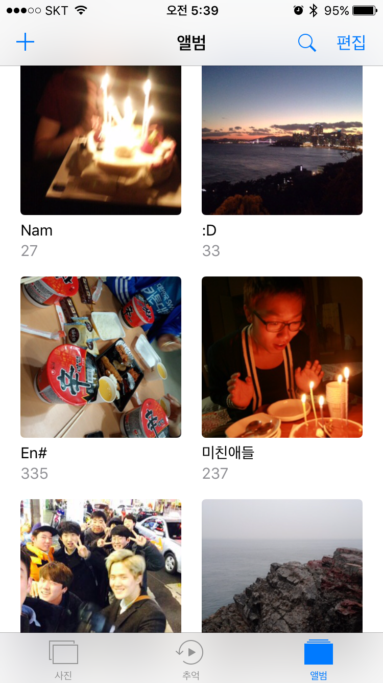
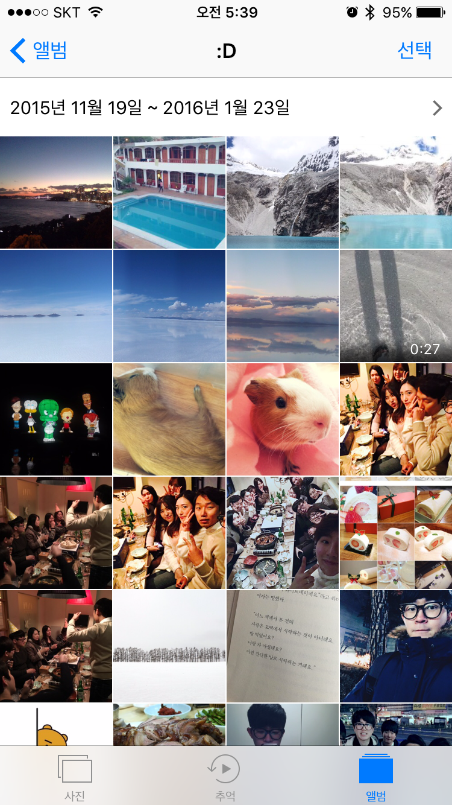

Slide 5
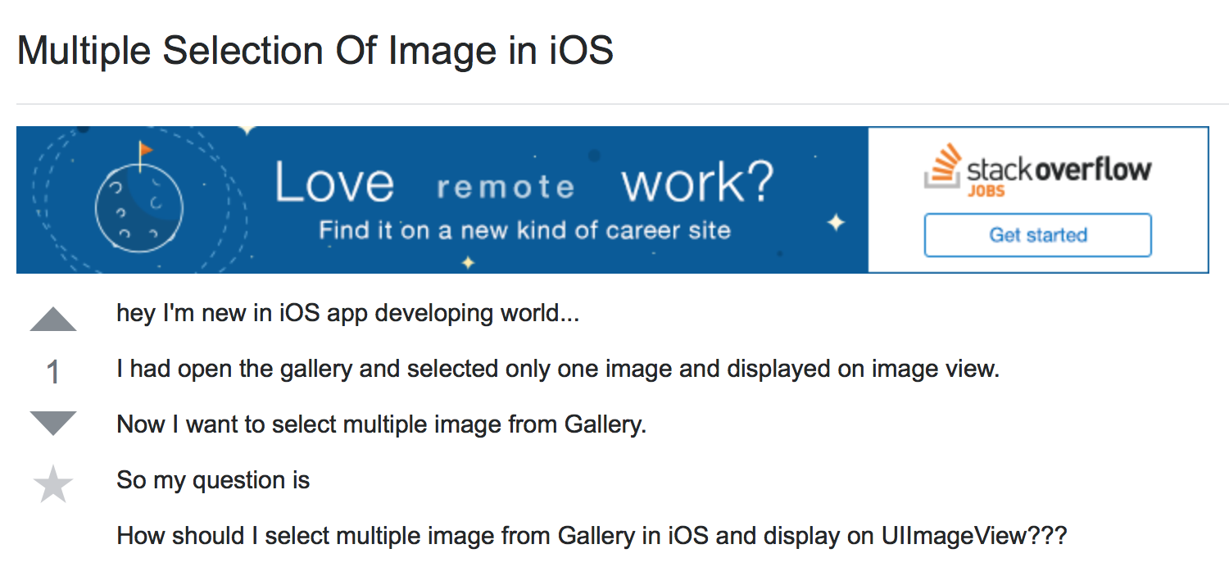
http://stackoverflow.com/questions/33935833/multiple-selection-of-image-in-ios

Slide 6
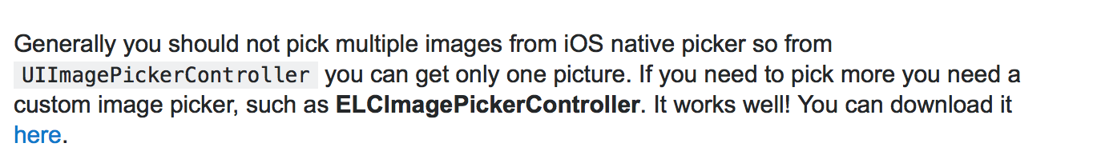

ELCImagePickerController, QBImagePicker 오픈소스 존재
http://stackoverflow.com/questions/33935833/multiple-selection-of-image-in-ios
Notes:
http://stackoverflow.com/questions/33935833/multiple-selection-of-image-in-ios

Slide 7
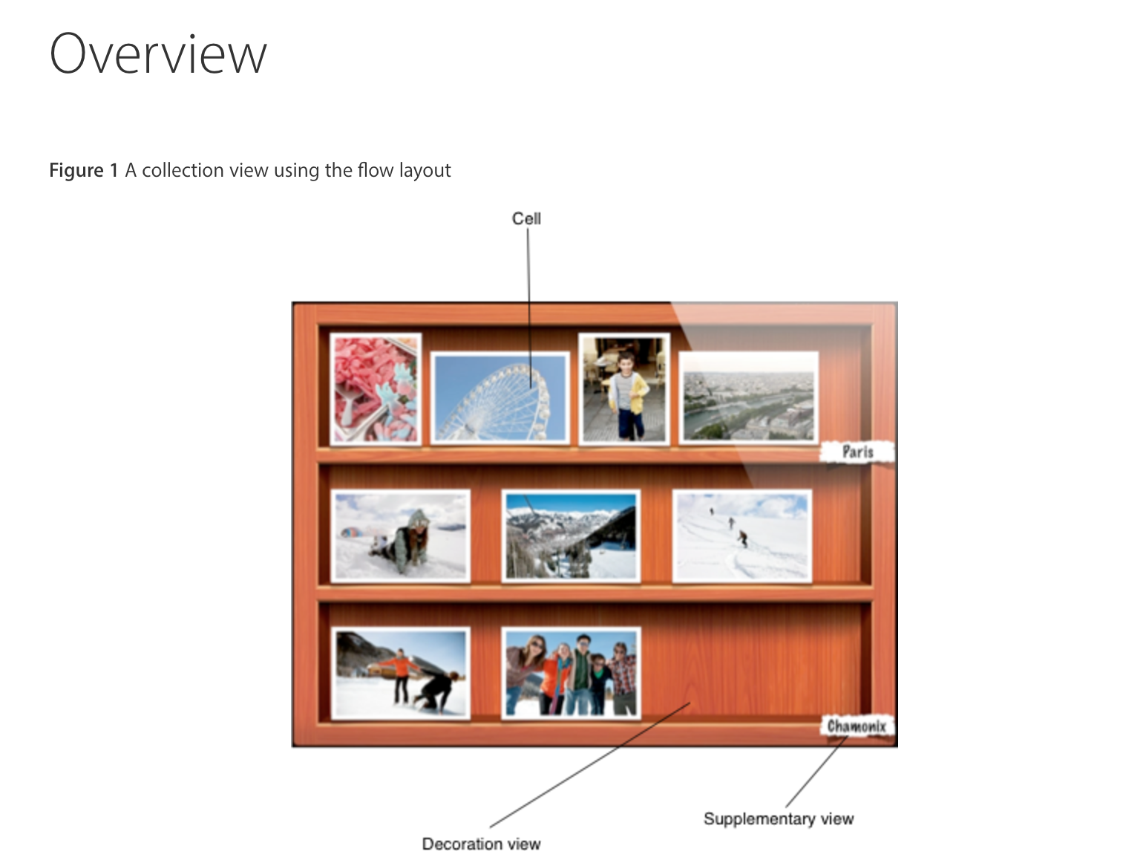

UICollectionView
Manages an ordered colleciton of data items and presents them using customizable layouts.
http://stackoverflow.com/questions/33935833/multiple-selection-of-image-in-ios
Notes:
http://stackoverflow.com/questions/33935833/multiple-selection-of-image-in-ios

Slide 8

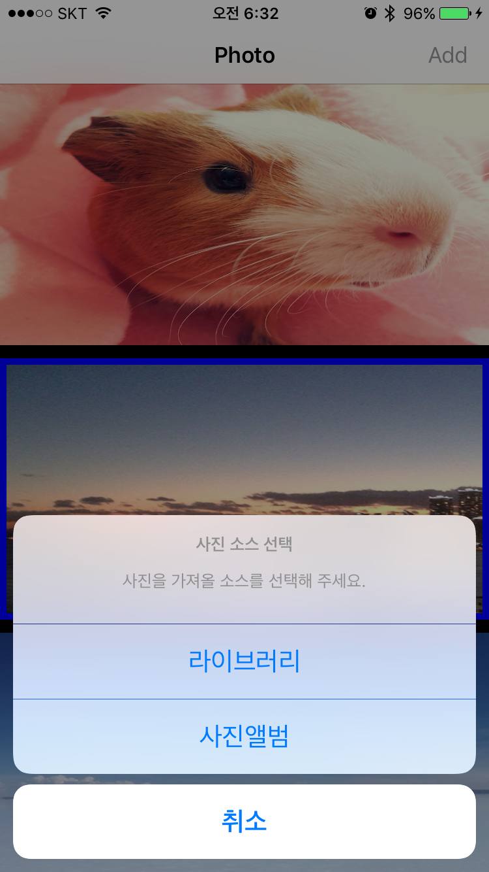
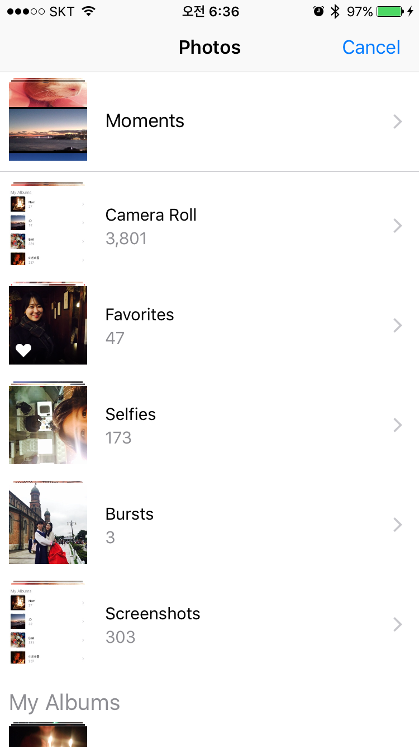
Notes:
http://stackoverflow.com/questions/33935833/multiple-selection-of-image-in-ios

Slide 9
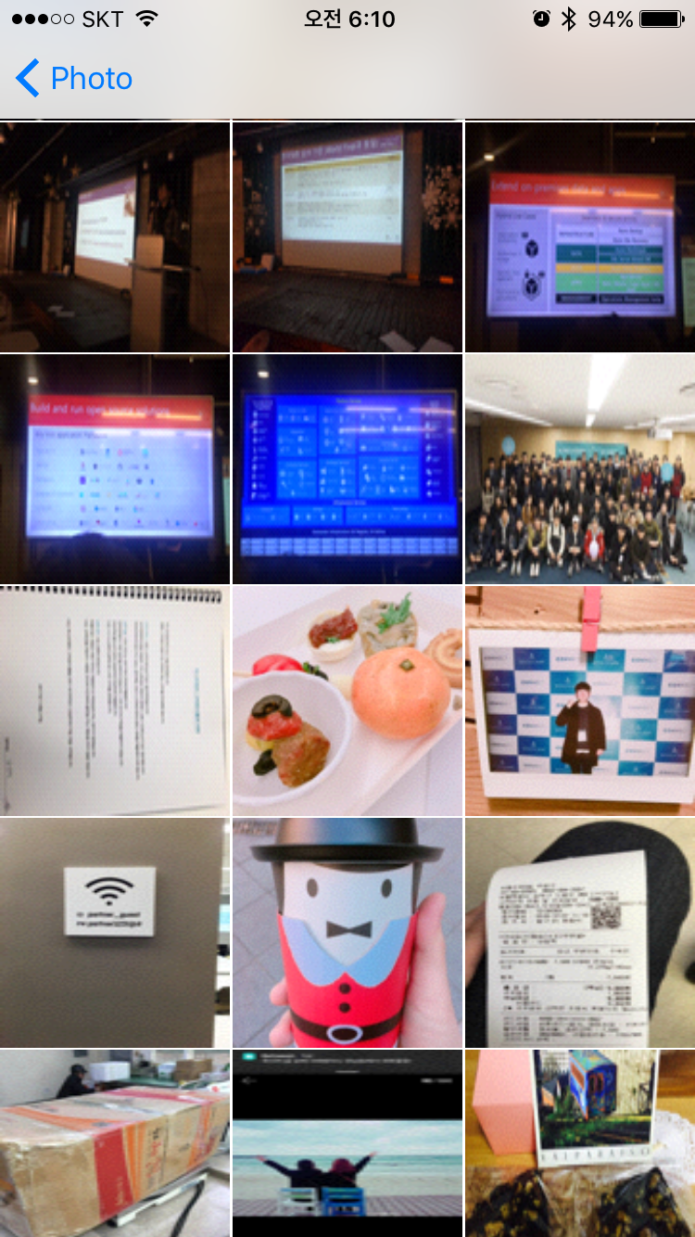
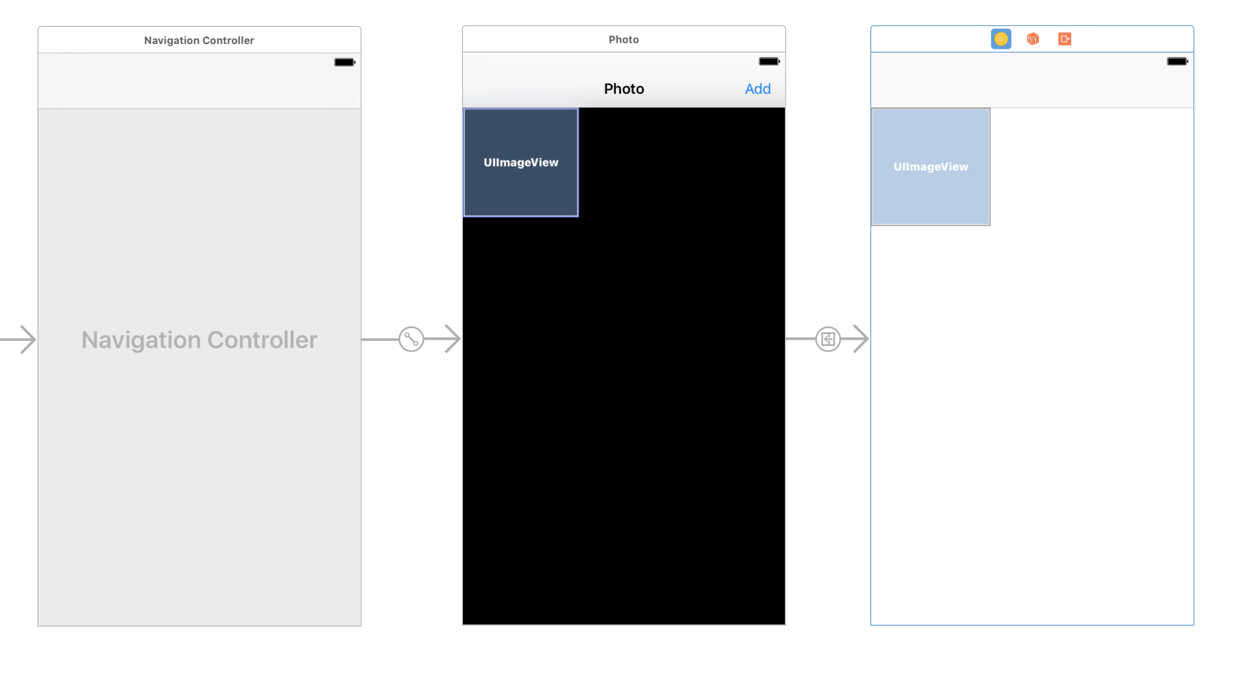
Notes:
http://stackoverflow.com/questions/33935833/multiple-selection-of-image-in-ios

Slide 10
PHAsset
A representation of an image, video or Live Photo in the Photos library
https://developer.apple.com/reference/photos/phasset
PHFetchResult
An ordered list of assets or collections returned from a Photos fetch method
- https://developer.apple.com/reference/photos/phfetchresult
PHImageManager
Provides methodos for retrieving or generating preview thumbnails and full-size image or video data associated with Photos assets.
https://developer.apple.com/reference/photos/phimagemanager
Notes:
http://stackoverflow.com/questions/33935833/multiple-selection-of-image-in-ios

